Slide 1



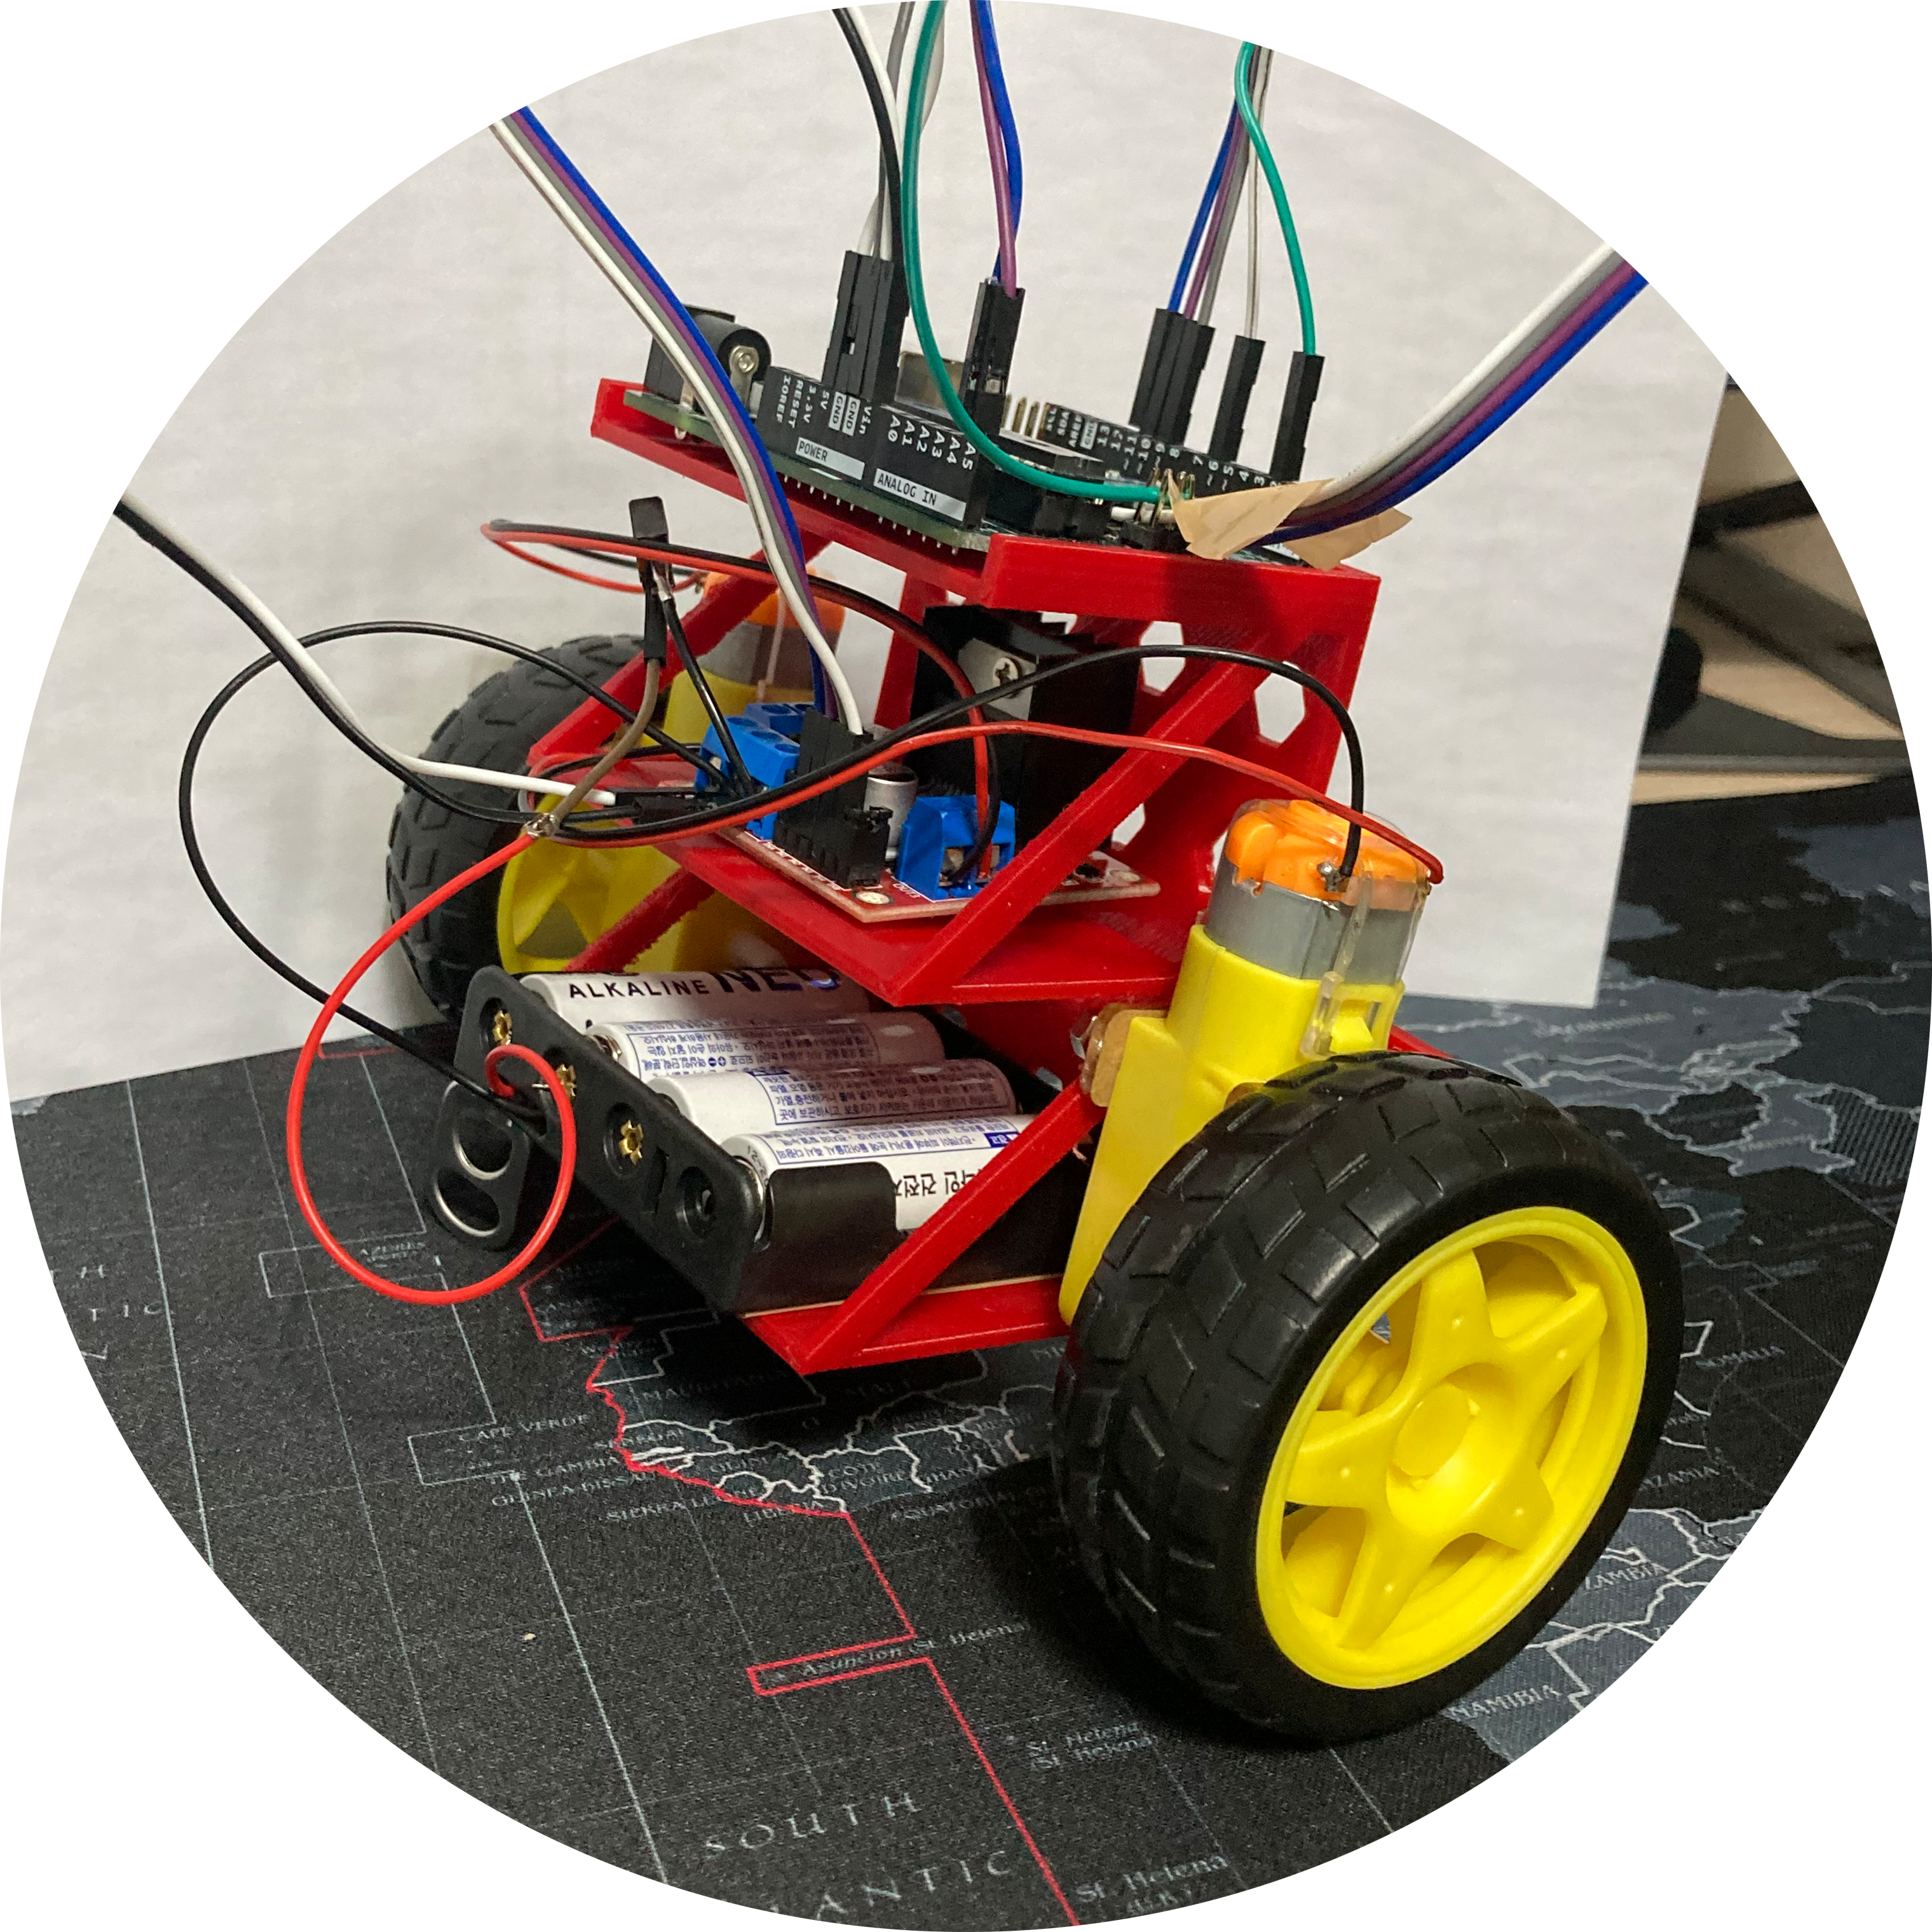



Final Project Presentation
Self balancing robot
Motor control

Slide 2


Team contribution
MIRJAVKHARBEK
12214737 (Team leader, Presenter)
NOZIMJON
12204507 (Designer and recorder)
TAAZIM
(Surveyor)

Slide 3



Project background
MAIN CONCEPT
The project aims to create a stable burger-shaped bot by utilizing an Arduino microcontroller, MPU6050 sensor, and PID-based motor control.
The bot's primary objective is to maintain balance and stability while moving on different surfaces, showcasing the effectiveness of sensor-driven control systems in robotics.

Slide 4
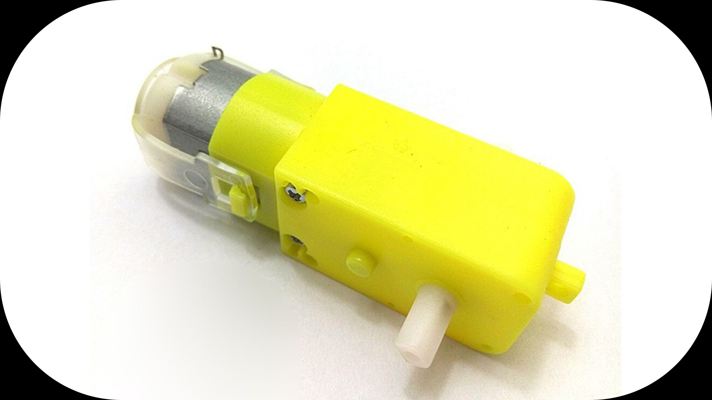
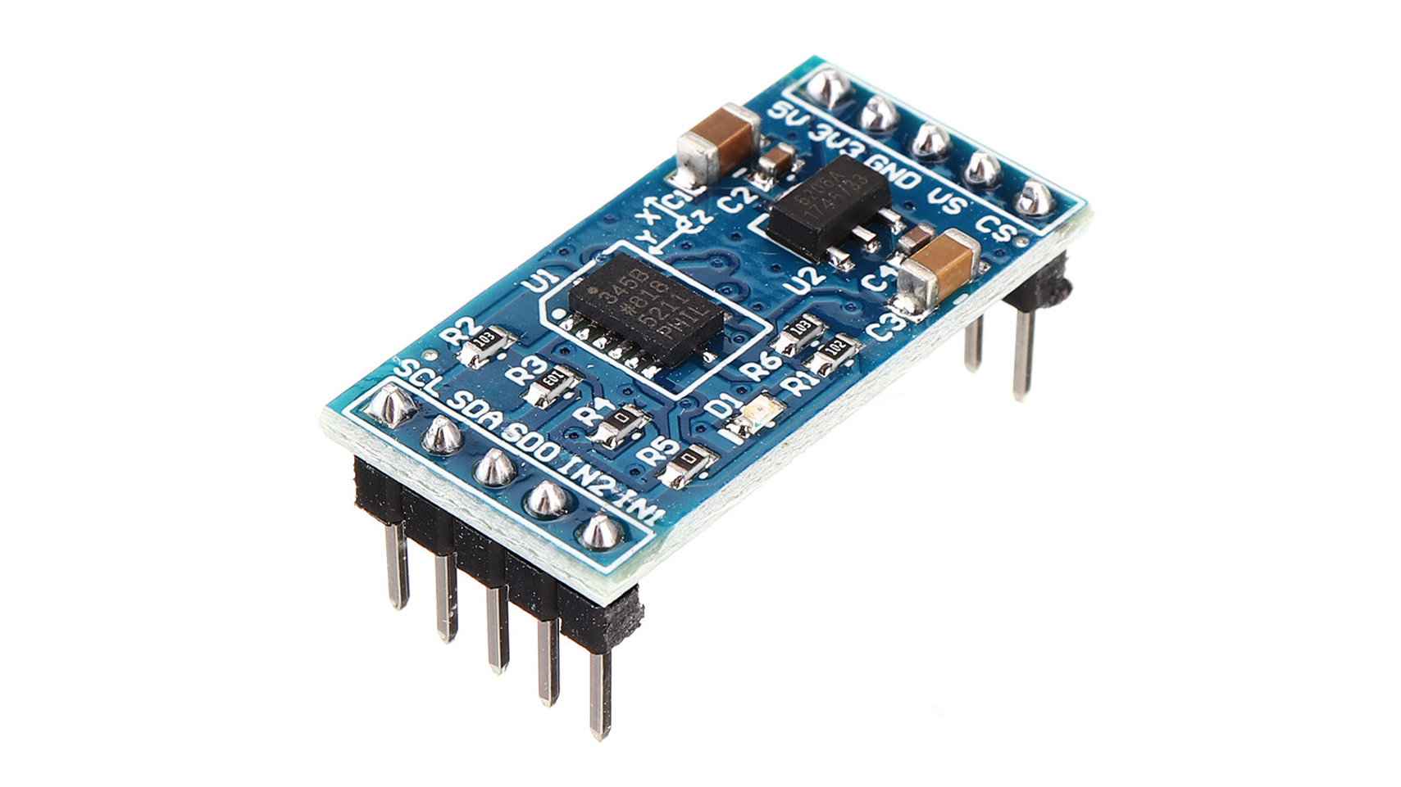
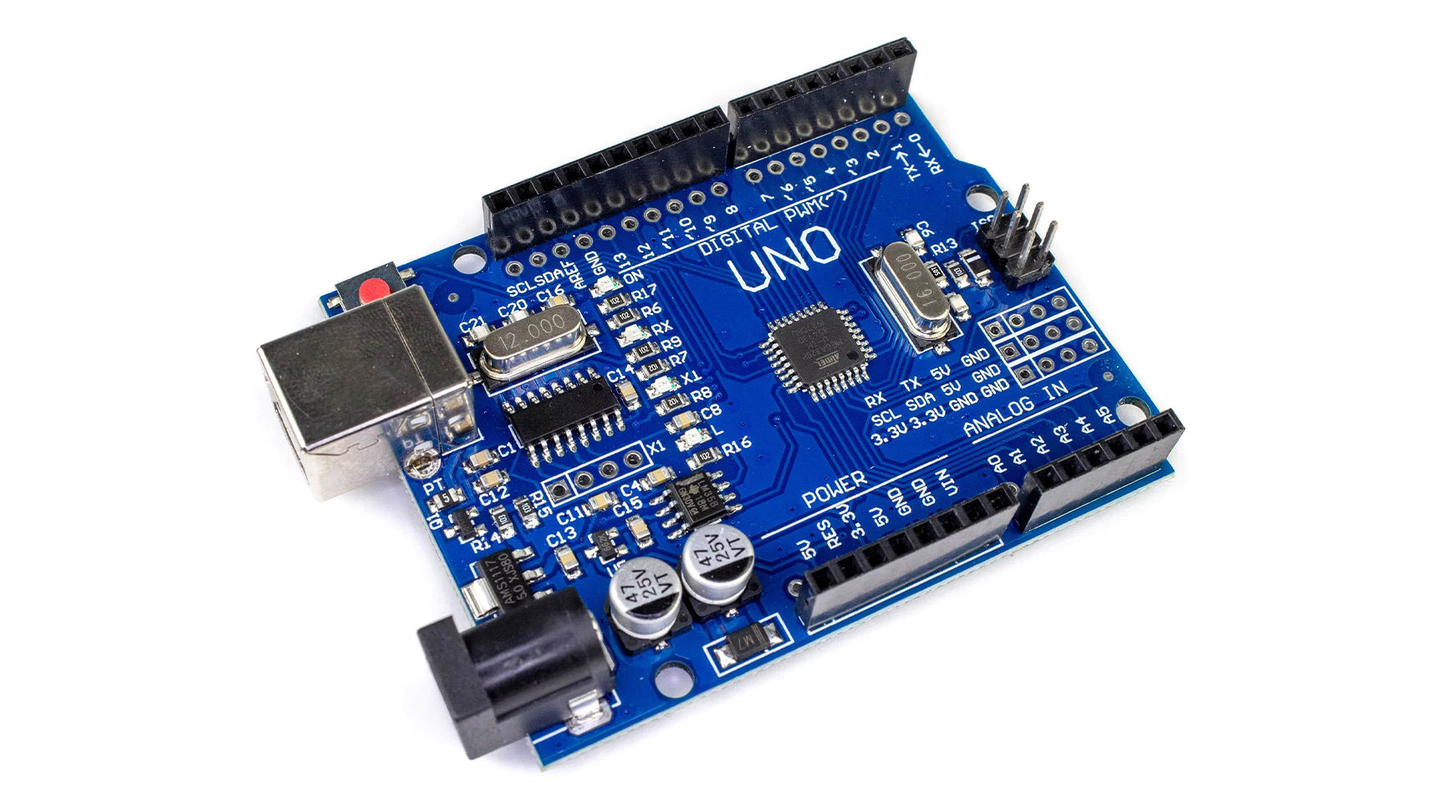
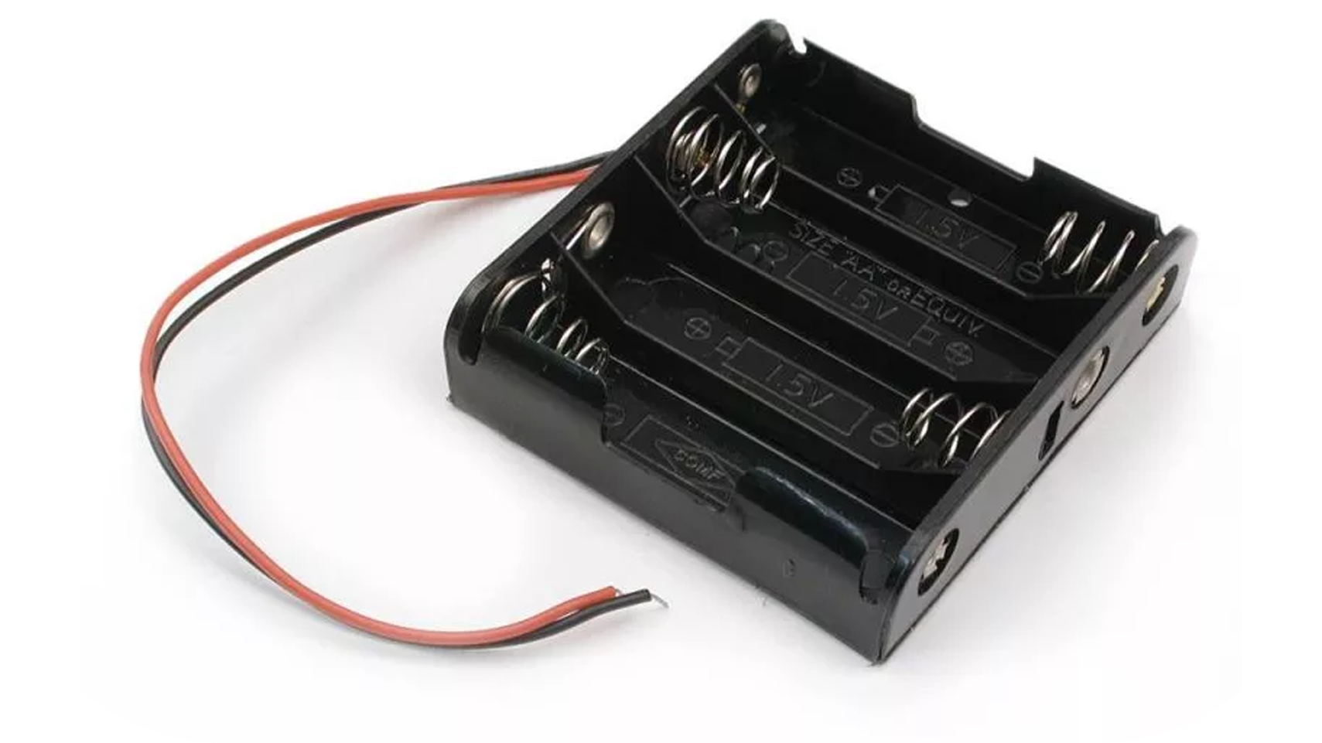
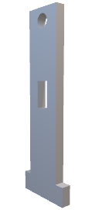
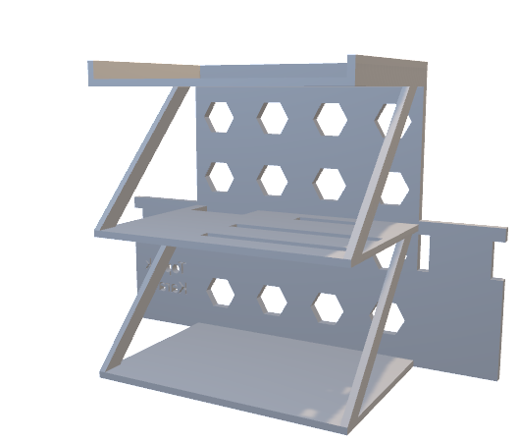
Device Architecture
DC motor
Mpu6050
Arduino uno
Battery holder
3D printed body

Slide 5
Sensor Fusion and Dynamic Adjustment
The MPU6050 sensor combines a gyroscope and accelerometer to measure rotational and linear motion. Gyroscopes detect changes in orientation, while accelerometers measure acceleration.
Together, they provide accurate data on an object's movement, crucial for our, where precise motion tracking and stability control are essential.

Slide 6
DMP(Digital Motion Processor)
DMP (Digital Motion Processor):
Function: The Digital Motion Processor is a feature present in some motion sensors (like the MPU6050) that offloads complex calculations from the main microcontroller.
Purpose: It allows the sensor to process sensor data internally, perform sensor fusion (combining data from multiple sensors), and provide processed orientation and motion data (like quaternion, gravity, yaw/pitch/roll) to the microcontroller.
Usage: DMP significantly reduces the computational load on the microcontroller, enabling efficient extraction of orientation and motion data, which is crucial for applications like orientation sensing and motion tracking.

Slide 7
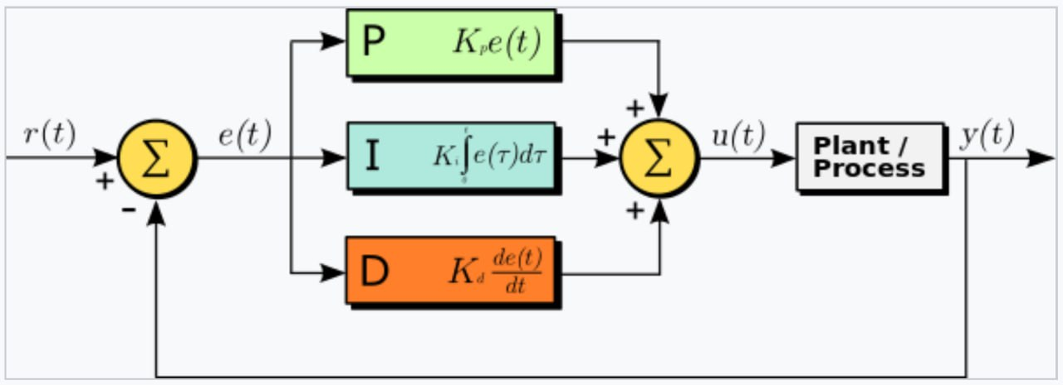
PID Control Implementation
PID (Proportional-Integral-Derivative) Controller:
Function: PID controllers are feedback control systems used to regulate processes based on measured feedback. It computes an error signal as the difference between a desired setpoint and a measured process variable.
Purpose: PID controllers aim to minimize the error signal by adjusting an output control signal. It consists of three terms: Proportional (P), Integral (I), and Derivative (D), which contribute to the control output based on present, past, and future errors, respectively.
Usage: In the context of robotics or systems control, PID controllers are commonly used for stability and motion control. They are employed to adjust motor outputs based on sensor feedback to maintain a desired setpoint or stability condition.

Slide 8
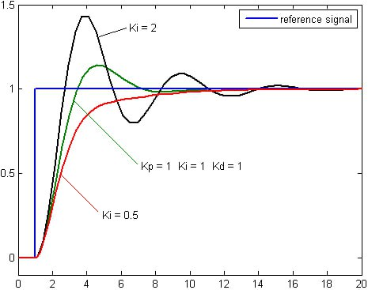
Integral term coefficient

Slide 9
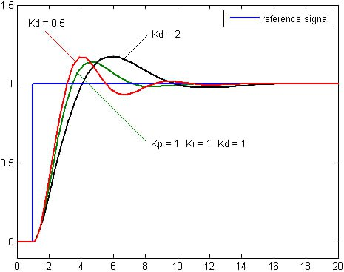
Derivative Term Coefficient

Slide 10
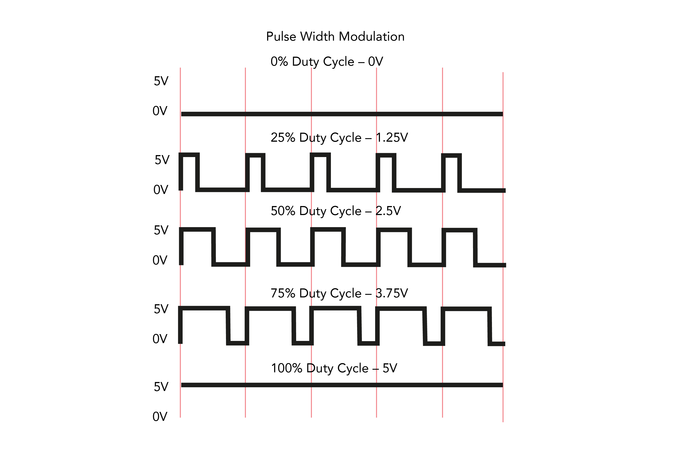
PWM (Pulse Width Modulation):
Function: PWM is a technique used to generate analog-like signals using digital means. It involves rapidly switching a digital signal ON and OFF at a fixed frequency, where the ratio of time ON to time OFF (duty cycle) determines the average voltage delivered.
Purpose: PWM signals are widely used to control the speed and power of motors, LEDs, and other devices. By varying the duty cycle of the signal, it's possible to control the average voltage or power supplied to a device.
Usage: In robotics and motor control, PWM signals are sent to motor drivers to control the speed and direction of DC motors. By adjusting the PWM duty cycle, you can regulate the motor's speed and direction, facilitating precise control and movement.

Slide 11
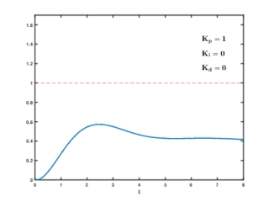
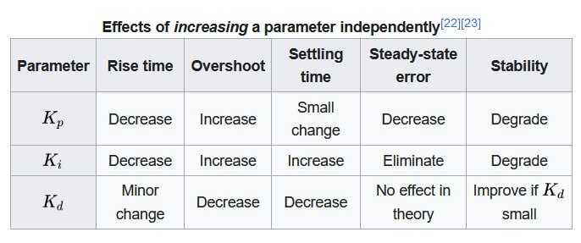
Animation and Table

Slide 12
Identified Challenge
Tuning PID Parameters:
Achieving optimal Proportional-Integral-Derivative (PID) parameters for precise motor control and stability can be challenging. Fine-tuning these parameters is crucial to avoid oscillations or sluggish responses.
Surface Adaptation:
Ensuring the robot maintains stability on various surfaces poses a challenge. Changes in friction or incline may impact the robot's balance, requiring adjustments in control algorithms to adapt to different terrains effectively.

Slide 13
Thank you
Q&A

